Slide 1
Sensitivity Analysis
Basic theory
Understanding optimum solution
Sensitivity analysis
Summer 2013

Slide 2
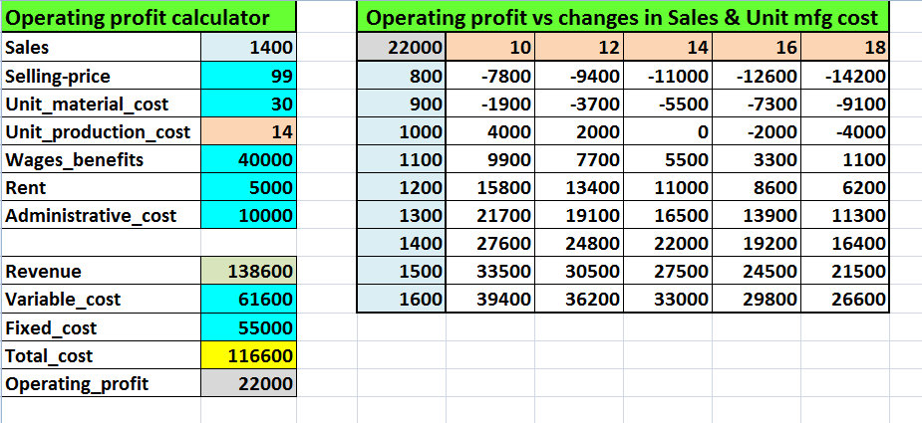
Introduction to Sensitivity Analysis
Sensitivity analysis means determining effects of changes in parameters on the solution. It is also called What if analysis, Parametric analysis, Post optimality analysis, etc,. It is not restricted to LP problems. Here is an example using Data Table.
We will now discuss LP and sensitivity analysis..

Slide 3
Primal dual relationship
10x₁ | + | 8x₂ |  | Max
0.7x₁ | + | x₂ | ≤ | 630
(½) x₁ | + | (5/6) x₂ | ≤ | 600
x₁ | + | (2/3) x₂ | ≤ | 708
(1/10) x₁ | + | (1/4) x₂ | ≤ | 135
-x₁ | - | x₂ | ≤ | -150
x1 ≥ 0, x2 ≥ 0
Consider the LP problem shown. We will call this as a “primal” problem. For every primal problem, there is always a corresponding LP problem called the “dual” problem.
630y₁ | + | 600y₂ | + | 708y₃ | + | 135y₄ | - | 150y₅ |  | Min
0.7y₁ | + | (½)y₂ |  | y₃ |  | (1/10)y₄ |  | -y₅ | ≥ | 10
y₁ | + | (5/6)y₂ | + | (2/3)y₃ | + | (1/4)₄ | - | y₂ | ≥ | 8
y₁ ≥ 0, y₂ ≥ 0, y₃ ≥ 0, y₄ ≥ 0, y₅ ≥ 0
Note the following
Any one of these can be called “primal”; the other one is “dual”.
If one is of the size m x n, the other is of the size n x m.
If we solve one, we implicitly solve the other.
Optimal solutions for both have identical value for the objective function (if an optimal solution exists).
Min
optimal
Max

Slide 4
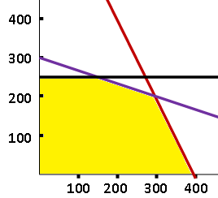
The Simplex Method
Consider a simple two product example with three resource constraints. The feasible region is shown.
Maximize | 15x₁ | + | 10x₂ | = | Z
 | 2x₁ | + | x₂ | ≤ | 800
 | x₁ | + | 3x₂ | ≤ | 900
 |  | + | x₂ | ≤ | 250
 | x₁ ≥ 0, x₂ ≥ 0
We now add slack variables to each constraint to convert these in equations.
Max | Z | - | 15x₁ | + | 10x₂ |  |  |  |  |  |  | = | 0
 |  |  | 2x₁ | + | x₂ | + | S₁ |  |  |  |  | = | 800
 |  |  | x₁ | + | 3x₂ |  |  | + | S₂ |  |  | = | 900
 |  |  |  | + | x₂ |  |  |  |  | + | S₃ | = | 250
Primal - dual
Maximize 15 x₁ + 10 x₂
Minimize 800 y₁ + 900 y₂ + 250 y₃

Slide 5
The Simplex Method: Cont…
Start with the tableau for Maximize 15 x₁ + 10 x₂
Z | x₁ | x₂ |  | S₁ | S₂ | S₃
1 | -15 | -10 |  | 0 | 0 | 0 | 0
0 | 2 | 1 |  | 1 | 0 | 0 | 800
0 | 1 | 3 |  | 0 | 1 | 0 | 900
0 | 0 | 1 |  | 0 | 0 | 1 | 250
Initial solution: Z = 0, x₁ = 0, x₂ = 0, S₁ = 800, S₂ = 900 and S₃ = 250.
After many iterations (moving from one corner to the next) we get the final answer.
Z | x₁ | x₂ |  | S₁ | S₂ | S₃
1 | 0 | 0 |  | 7 | 1 | 0 | 6500
0 | 1 | 0 |  | 3/5 | -1/5 | 0 | 300
0 | 0 | 1 |  | -1/5 | -2/5 | 0 | 200
0 | 0 | 0 |  | 0 | 0 | 1 | 50
Optimal solution:
Z = 6500, x₁ = 300, x₂ = 200 and S₃ = 50.
Z = 15 * 300 + 10 * 200 = 6500
Notice 7, 1, 0 in the objective row.
These are the values of dual variables, called shadow prices.
Minimize 800 y₁ + 900 y₂ + 250 y₃ gives 800*7 + 900*1 + 250*0 = 6500

Slide 6
Solver “Answer Report”
Maximize 10 x₁ + 8 x₂ = Z
① 7/10 x₁ + x₂ ≤ 630
② 1/2 x₁ + 5/6 x₂ ≤ 600
③ x₁ + 2/3 x₂ ≤ 708
1/10 x₁ + 1/4 x₂ ≤ 135
x₁ ≥ 0, x₂ ≥ 0 ⑤ x₁ + x₂ ≥ 150
Consider the Golf Bag problem.
Optimal solution: x₁ = 540, x₂= 252. Z = 7416
Binding constraints: constraints intersecting at the optimal solution. ①,③
③
Nonbinding constraint? ②,④ and ⑤
②
Now consider the Solver solution.
⑤
①
④

Slide 7
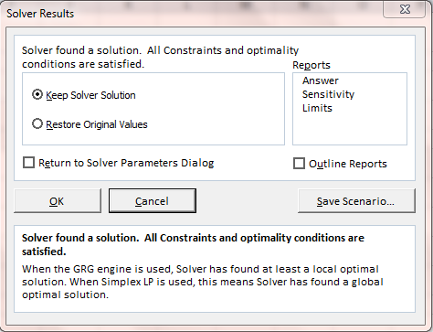
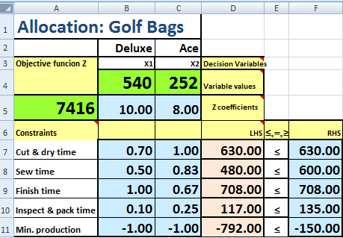
Set up the problem, click “Solve” and the box appears.
➔
If you select only “OK”, you can read values of decision variables and the objective function.
Instead of selecting only “OK”, select “Answer” under Reports and then click “OK”. A new sheet called “Answer Report xx” is added to your workbook.
Next slides shows the report (re-formatted).

Slide 8
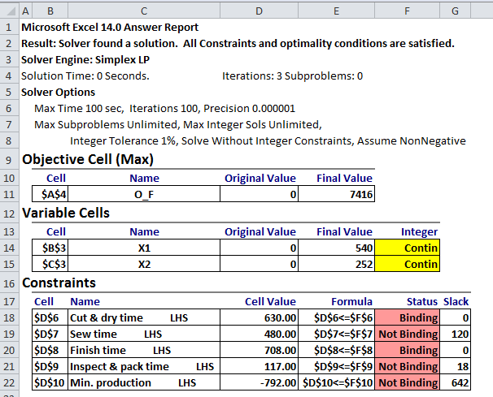
Answer Report
The answer report has three tables:
1: Objective Cell – for the objective function
2: Variable Cells 3: for constraints.
Let’s try to interpret some features..
Optimal profit
Optimal variable values
?
You may want to rename this Answer Report worksheet.

Slide 9
Sensitivity Analysis
Now we will consider changes in the objective function or the RHS coefficients – one coefficient at a time.
Objective function
Maximize 10 x₁ + 8 x₂ = Z
① 7/10 x₁ + x₂ ≤ 630
② 1/2 x₁ + 5/6 x₂ ≤ 600
③ x₁ + 2/3 x₂ ≤ 708
1/10 x₁ + 1/4 x₂ ≤ 135
x₁ + x₂ ≥ 150
x₁ ≥ 0, x₂ ≥ 0
Right Hand Side (RHS).
Optimal solution:
x₁ = 540, x₂= 252. Z = 7416
Here are some questions we will try to answer.
Q1: How much the unit profit of Ace can go up or down from $8 without changing the current optimal production quantities?
Q2:What if per unit profit for Deluxe model is 12.25?
Q3: What if an 10 more hours of production time is available in
① cutting & dyeing? ④ inspection?

Slide 10
Sensitivity Analysis
Maximize 10 x₁ + 8 x₂ = Z
① 7/10 x₁ + x₂ ≤ 630
② 1/2 x₁ + 5/6 x₂ ≤ 600
③ x₁ + 2/3 x₂ ≤ 708
1/10 x₁ + 1/4 x₂ ≤ 135
x₁ ≥ 0, x₂ ≥ 0 ⑤ x₁ + x₂ ≥ 150
Golf bags
X₁: Deluxe
X₂: Ace
Q1: How much the unit profit of Ace can go up or down from $8 without changing the current optimal production quantities?
As long as the slope of the objective function isoprofit line stays within the binding constraints.
②
③
⑤
①
④

Slide 11
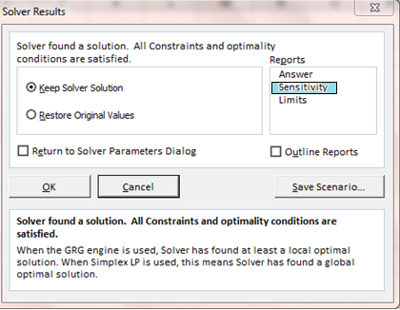
Solver “Sensitivity Report”
If you click on Sensitivity, a new worksheet, called Sensitivity Report is added. It contains two tables: Variable cells and Constraints.
Variable cells table helps us answer questions related to changes in the objective function coefficients.
Constraints table helps us answer questions related to changes in the RHS coefficients.
We will discuss these tables separately.

Slide 12
Solver “Sensitivity Report”
Z = 7416
x₁ = 540, x₂= 252
Maximize 10 x₁ + 8 x₂ = Z
Q1: How much the unit profit of Ace can go up or down from $8 without changing the current optimal production quantities?
Range for X1: 10 – 4.4 to 10 + 2
Range for X2: 8 – 1.333 to 8 + 6.286
Try per unit profit for X2 as 14.28, 14.29, 6.67 and 6.66
Q2:What if per unit profit for Deluxe model is 12.25?
Slight round off error?
Reduced cost will be explained later.

Slide 13
What if questions are about the RHS?
A change in RHS can change the shape of the solution space (objective function slope is not affected).
Q3: Add 10 more hours of production time for
① cutting & dyeing? ④ inspection?
Cutting & dyeing is a binding constraint; increasing the resource will increase the solution space and move the optimal point.
①
Inspection is a nonbinding constraint; increasing the resource will increase the solution space and but will not move the optimal point.
④
⑤

Slide 14
Sensitivity Report Q3
Q3: Add 10 more hours of production time for
① cutting & dyeing? ④ inspection?
For cutting & dyeing up to 52.36 units can be increased. Profit will increase @ $2.50 per unit.
For inspection ?
Shadow price represents change in the objective function value per one-unit increase in the RHS of the constraint. In a business application, a shadow price is the maximum price that we can pay for an extra unit of a given limited resource.

Slide 15
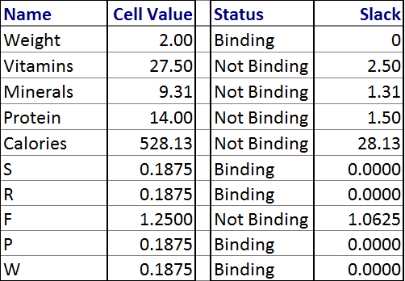
Trail Mix : sensitivity analysis
Cost / unit: $ | S: $4 | R: $5 | F: $3 | P: $7 | W: $6 | Min. needed
 | Grams / lb.
Vitamins | 10 | 20 | 10 | 30 | 20 | 25.00
Minerals | 5 | 7 | 4 | 9 | 2 | 8.00
Protein | 1 | 4 | 10 | 2 | 1 | 12.50
Calories/lb | 500 | 450 | 160 | 300 | 500 | 500
Answer Report
Seeds, Raisins, Flakes, Pecans, Walnuts: Min. 3/16 pounds each
Total quantity = 2 lbs.

Slide 16
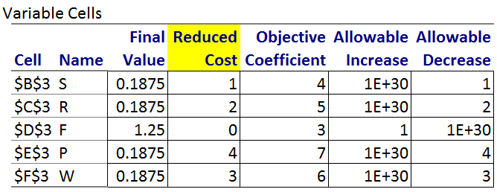
Trail Mix : Cont…
Interpretation of allowable increase or decrease?
What is reduced cost? Also called the opportunity cost.
One interpretation of the reduced cost (for the minimization problem) is the amount by which the objective function coefficient for a variable needs to decrease before that variable will exceed the lower bound (lower bound can be zero).

Slide 17
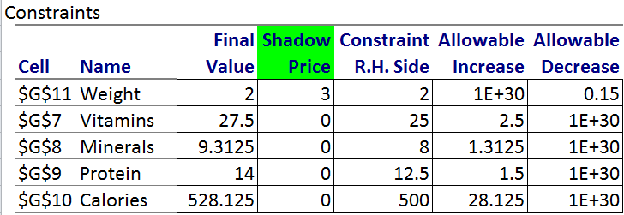
Trail Mix : Cont….
Explain allowable increase or decrease and shadow price

Slide 18
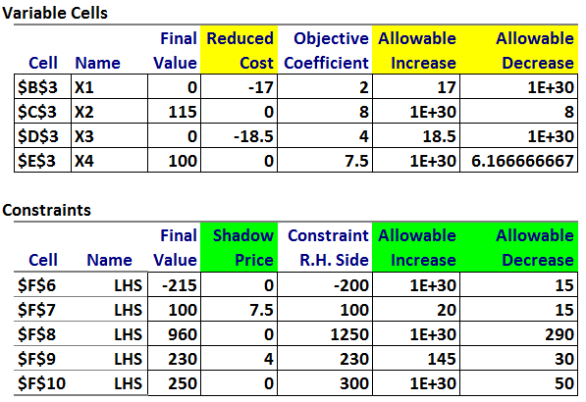
Example 5
Max | 2.0x₁ | + | 8.0x₂ | + | 4.0x₃ | + | 7.5x₄ | = | Z
 | x₁ | + | x₂ | + | x₃ | + | x₄ | ≥ | 200
 | 2.0x₁ |  |  | + | 3.0x₃ | + | x₄ | ≤ | 100
 |  | + | 4.0x₂ | + |  | + | 5.0x₄ | ≤ | 1250
 | x₁ | + | 2.0x₂ |  |  |  |  | ≤ | 230
 |  |  |  |  | 4.0x₃ | + | 2.5x₄ | ≤ | 300
x₁ ≥ 0, x₂ ≥ 0, x₃ ≥ 0, x₄≥ 0
Optimal: Z = 1670, X2 = 115, X4 = 100
Reduced Cost (for maximization) : the amount by which the objective function coefficient for a variable needs increase before that variable will exceed the lower bound.
Shadow price represents change in the objective function value per one-unit increase in the RHS of the constraint. In a business application, a shadow price is the maximum price that we can pay for an extra unit of a given limited resource.

Slide 19
Objective Function
Right Hand Side
Change one coefficient at a time within allowable range
The feasible region does not change.
Since constraints are not affected, decision variable values remain the same.
Objective function value will change.
Feasible region changes.
If a nonbinding constraint is changed, the solution is not affected.
If a binding constraint is changed, the same corner point remains optimal but the variable values will change.

Slide 20
Miscellaneous info:
We did not consider many other topics . Example are:
Addition of a constraint.
Changing LHS coefficients.
Variables with upper bounds
Effect of round off errors.
What did we learn?
Solving LP may be the first step in decision making; sensitivity analysis provides what if analysis to improve decision making.

